Slide 1
Financial-News Retrieval-Augmented-Generation Assistant
Chen Yang | NUID 002837912

Slide 2
Motivation
Investors face information overload → thousands of headlines, scattered prices
Pure language-models hallucinate or go stale
Goal: merge fresh news + live market data → one grounded answer

Slide 3
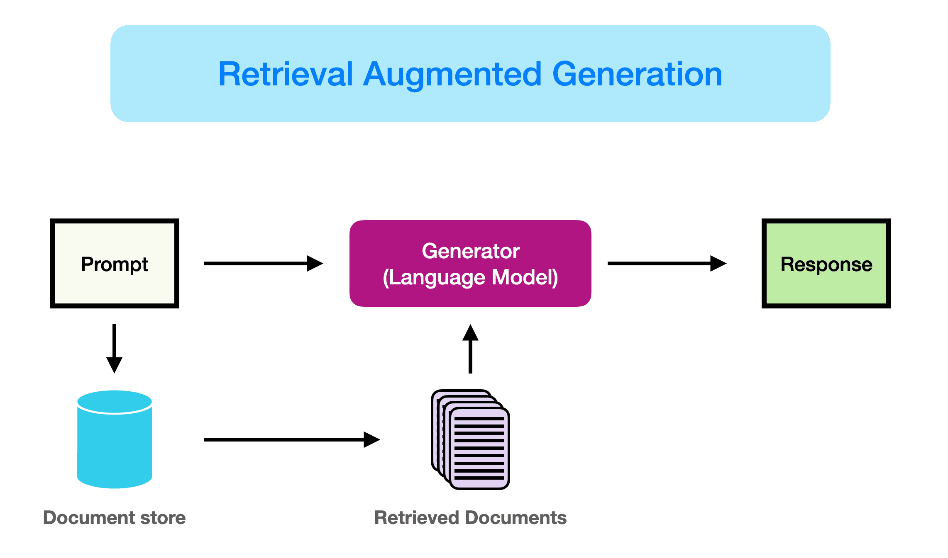
Architecture Overview
Diagram with 4 blocks:
News Corpus → Embeddings → FAISS
User Query
Retriever + Price-Fetcher
DistilGPT-2 Generator → Answer
RAG = Retrieval + Augmentation + Generation

Slide 4
Data Pipeline
Dataset: 2,800 CNBC headlines (2019-2024)
yahoo finance api
Cleaning: timestamp normaliser (convert_time), text lower-case & de-spaced
Embedding: token-average DistilGPT-2 → 768-d vectors
FAISS index built in memory

Slide 5
Live Price Context
yfinance helper grabs last 30-day closes per ticker
Summarizer computes USD, % change, last close, sample points
Regex detects 1-5 char tickers in user query (e.g., TSLA, AAPL)

Slide 6
Prompt Construction
News context:
<top-k headlines>
Stock-price context:
TSLA: From 2025-03-13 to 2025-04-24 …
Question: <user query>
Answer concisely:
Both qualitative and quantitative evidence fed to the LLM

Slide 7
Decoding & Guardrails
DistilGPT-2, 82 M params, greedy decoding
repetition_penalty 1.25, no_repeat_ngram_size 4
Post-trim keeps first 2 sentences → prevents loops / spam

Slide 8
Demo
Query: “What drove TSLA this month and where does it stand?”
Show generated answer (1 paragraph)
Highlight how news facts + % price move are both present

Slide 9
Evaluation & Results
Manual checks: factual vs headline & Yahoo data – high alignment
Latency ≈ 0.8 s per query (0.5 s yfinance, 0.3 s generator)
Cost: zero paid tokens; runs on CPU / free GPU

Slide 10
Limitations & Roadmap
Only headlines, no full articles → add SEC filings
Regex ticker detection → upgrade to NER lookup table
Switch generator to instruction-tuned Mistral-7B for better style
Cache yfinance nightly to cut latency
Wrap in Streamlit front-end for public demo

